Slide 1


K. RAMAKRISHNAN COLLEGE OF ENGINEERING
(AUTONOMOUS), SAMAYAPURAM - TRICHY
DEPARTMENT OF EEE
EGB1201 – JAVA PROGRAMMING
ONLINE JOB PORTAL
PRESENTED BY SUPERVISOR
RUPASRI.R Mr.K.Swaminathan
8115U24EE048 Assistant Professor / CSE

Slide 2
PRESENTATION OVERVIEW
Project Introduction
Objective
Problem Statement
Technologies Used
Architecture Diagram
Modules Used
Screenshots
References

Slide 3
PROJECT INTRODUCTION
The Online Job Portal is a web-based system that helps job seekers find suitable jobs and allows employers to post vacancies and hire candidates easily, making the recruitment process faster and more efficient.

Slide 4
OBJECTIVE
The objective of the Online Job Portal is to connect job seekers and employers through a simple platform that enables easy job posting, searching, and application, saving time and effort in the recruitment process.

Slide 5
PROBLEM STATEMENT
Finding jobs and hiring candidates through traditional methods is slow and limited, so an online system is needed to make the process faster and easier.

Slide 6
TECHNOLOGIES USED
Frontend: HTML,CSS
Backend: PHP,JAVA
Database: MySQL
Development Tools: Apache

Slide 7
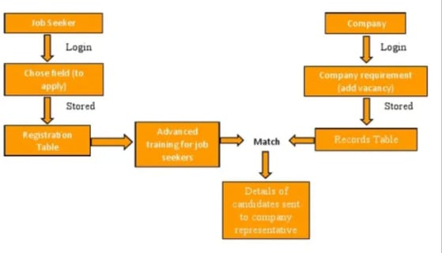
ARCHITECTURE DIAGRAM

Slide 8
MODULES USED
User Module – Registration
Employer Module – Job posting
Admin Module – Manage users
Notification Module – Alerts for new jobs and application updates

Slide 9
MODULE 1
(USER MODULE)
Register and log in as job seeker or employer.
Manage personal details and account settings.
Secure authentication and profile access.

Slide 10
MODULE 2
(JOB SEEKER MODULE)
Create and update resume/profile with skills and experience.
Search and apply for jobs using filters (location, role, salary).
Track application status and receive notifications.

Slide 11
MODULE 3
(EMPLOYER MODULE)
Post job vacancies with detailed descriptions.
Search candidate profiles and short-list suitable applicants.
Manage applications and schedule interviews.

Slide 12
MODULE 4
(ADMIN MODULE)
Manage users (job seekers and employers).
Approve or monitor job postings and activities.
Maintain database security and system performance.

Slide 13
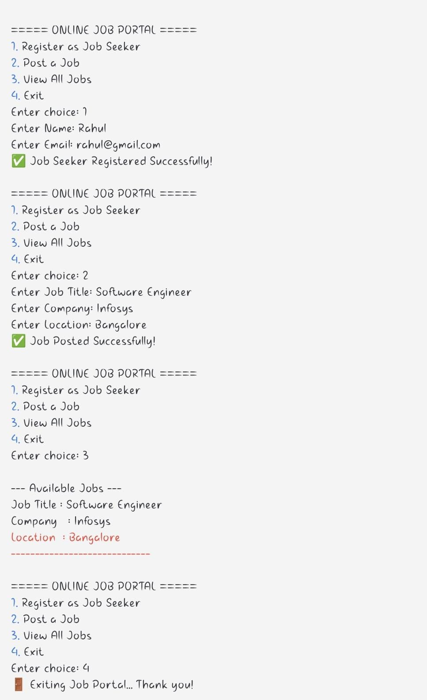
OUTPUT SCREENSHOTS

Slide 14
REFERENCES
PHP Official Documentation – https://www.php.net/docs.php
MySQL Documentation – https://dev.mysql.com/doc
TutorialsPoint – https://www.tutorialspoint.com

